Slide 1
Hit the Ground Running!
RDA Training for Music Catalogers
February 27, 2013

Slide 2
245 10 Creating RDA bibliographic records in MARC : $b a walkthrough. $n Part 2, $p Audio disc / $c
Kevin Kishimoto,
University of Chicago.

Slide 3
Notes:
Demonstration on cataloging a CD using RDA elements within MARC.

Slide 4
Same old OCLC work form... (...same old slide)
Fixed fields
Ldr/18 - Desc = i
MARC 040
$b eng
$e rda
$e follows directly after $b
040 __ CGU $b eng $e rda $c CGU
Notes:
Use OCLC sound recording workform.
Set the fixed field Desc = i.
040 $b eng is followed immediately by $e rda.

Slide 5
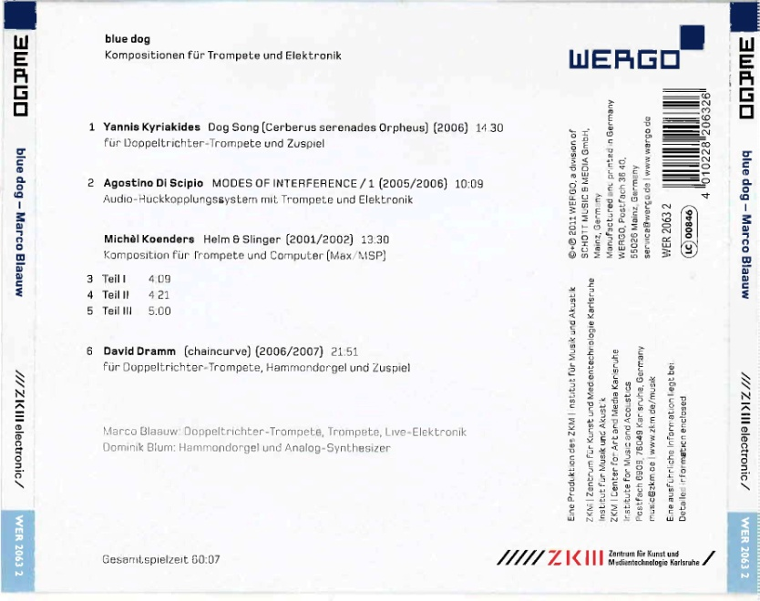
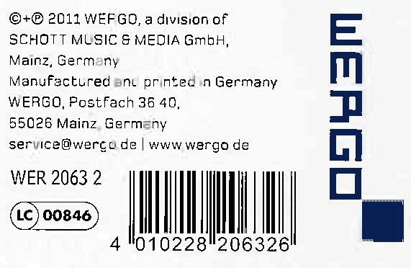
MARC 02X
MARC 024 / 028
RDA 2.15 - Identifier for the Manifestation
024 3_ 4010228206326
028 02 WER 2063 2 $b WERGO
Notes:
For the purposes of this demonstration, I will create the access points after completing the descriptive attributes.
First record the identifiers for the manifestation in the 024 and 028.

Slide 6
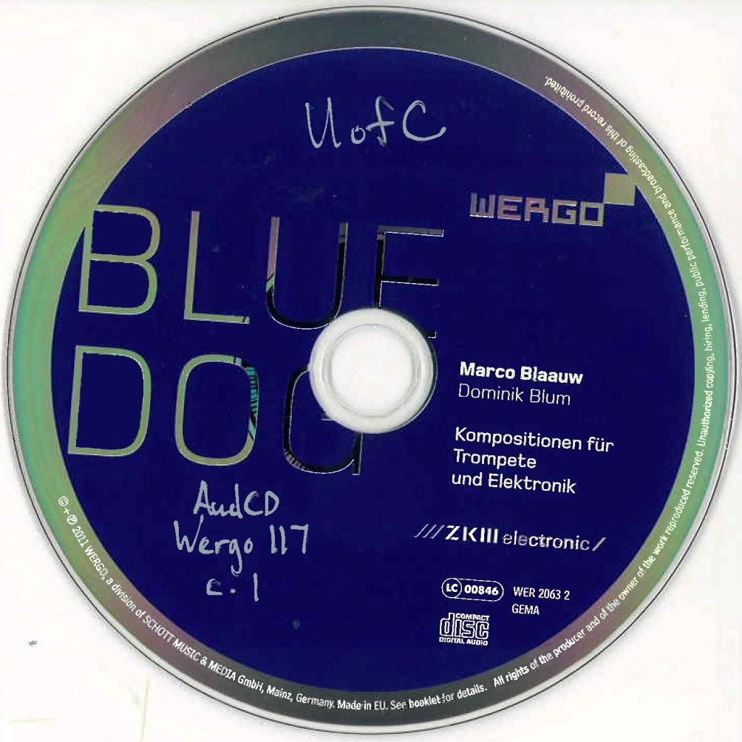
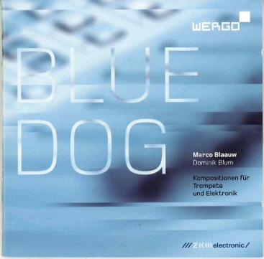
MARC 2XX
MARC 245
RDA 2.3 - Title & RDA 2.4 -
Statement of responsibility
245 00 Blue dog : $b Kompositionen für Trompete und Elektronik.
or
245 00 BLUE DOG : $b Kompositionen für Trompete und Elektronik.
Notes:
The preferred source of information for a CD is the disc label.
RDA 2.4.1.1 says, Statements identifying performers of music whose participation is confined to performance, execution, or interpretation are not transcribed. Therefore Marco Blaauw and Dominik Blum are not included in the 245.

Slide 7
MARC 2XX
MARC 264
RDA 2.8-2.10 - Publication / Distribution / Manufacture statement
RDA 2.11 - Copyright date
264 _1 Mainz, Germany : $b WERGO, $c [2011]
264 _4 $c ℗2011
Notes:
Supply a publication date instead of using “[date of publication not identified]” if possible.
264 _4 (copyright date) has no ending punctuation.

Slide 8
MARC 3XX
MARC 300
RDA 3.4 - Extent
see RDA 7.22 for duration
see also ISBD 5.1.3 & ISBD 5.1.5.1
1 audio disc (60 min., 7 sec.)
or
1 audio disc (60:07)
Notes:
RDA uses the term “audio disc” instead of “sound disc.”
RDA 7.22 does not say where to record the duration of an audio recording, and the RDA to MARC mappings are not exact. For further clarification, we look to ISBD 5.1.3 and 5.1.5.1, which instruct us to record the playing time in parentheses within the extent.

Slide 9
MARC 3XX
MARC 300
RDA 3.5 - Dimensions
LC-PCC PS 3.5.1.4.4: “Record the diameter of discs in inches.”
300 __ 1 audio disc (60 min., 7 sec.) ; $c 4 3/4 in.
Notes:
Following LC-PCC PS 3.5.1.4.4, record diameters of discs in inches.

Slide 10
MARC 3XX
MARC 336, 337, 338
RDA 6.9, 3.2, 3.3
336 __ performed music $2 rdacontent
337 __ audio $2 rdamedia
338 __ audio disc $2 rdacarrier
Notes:
33X fields…

Slide 11
MARC 3XX
MARC 344 & 347 - new MARC fields for RDA elements
RDA 3.16 - Sound characteristic & RDA 3.19 - Digital file characteristic
340 __ $b 4 3/4 in.
344 __ digital $b optical $c 1.4 m/s $g stereo $2 rda
347 __ audio file $b CD audio $2 rda
This data also coded in MARC 007
007 __ s $b d $d f $e s $g g $j m $k m $m e $n d
Notes:
MARC 344 and 347 are new fields to record Sound characteristics & Digital file characteristics.
To save time, I’ve created constant data in Connexion to help me fill in these fields as well as the 336, 337, 338.

Slide 12
MARC 3XX
RDA to MARC bibliographic mapping to 300 $b
300 __ 1 audio disc (60 min., 7 sec.) : $b digital, optical, 1.4 m/s, stereo, CD audio ; $c 4 3/4 in.
MLA’s Best practices for music cataloging using RDA and MARC21 (draft, 11 February 2013)
use 007 and 34X fields to record this data
not 300 $b
Notes:
What about 300 $b? RDA to MARC bibliographic mapping shows many of these elements mapped to 300 $b, but this can lead to very lengthy 300s, as seen here.
Use the chart in the MLA Best practices document and code this data in other fields.
(Some local catalogs may not be able to use the data in the 34X fields, so catalogers may still need to use the 300 $b for the public catalog; testing is necessary. As of this presentation, I continue to record some of the more commonly useful data in the 300 $b.)

Slide 13
MARC 5XX
RDA 2.20.2 - Note on title
500 __ Title from disc label.
RDA 7.23 - Performer, narrator, and/or presenter
511 0_ Marco Blaauw, double-bell trumpet, trumpet, live electronics ; Dominik Blum, Hammond organ, analog synthesizer (4th work).
RDA 7.11 - Place and date of capture
518 __ $o Recorded $d 2002-2006, $p ZKM Institut für Musik und Akustik, Karlsruhe.
Notes:
“Title from disc label” is required. (Another good use of constant data.)
Notice the new subfields in the 518 which are used to record the elements from RDA 7.11. The $o is not an RDA element, but examples in MARC21 format demonstrate how to use this subfield.

Slide 14
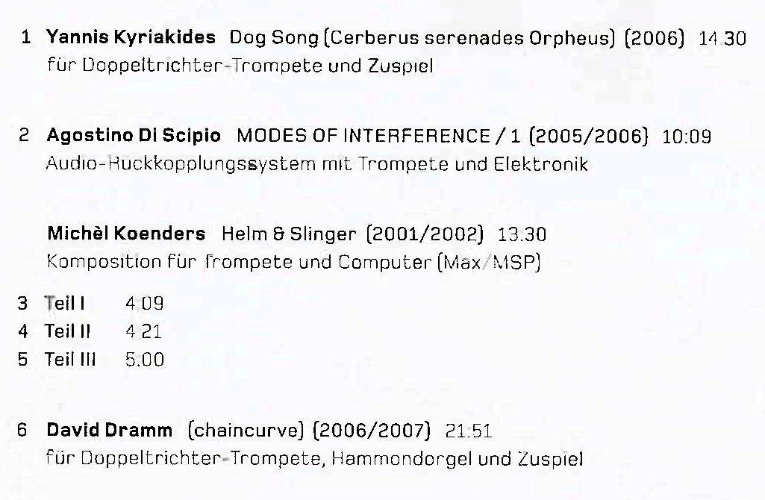
MARC 5XX
RDA 26.1 - Related expression
Structured description of the related expression
Notes:
Structured contents note for the CD.

Slide 15
MARC 5XX
RDA 26.1 - Related expression
Structured description of the related expression
505 80 $g Contains: $t Dog song : (Cerberus serenades Orpheus) / $r Yannis Kyriakides $g (14:30) -- $t Modes of interference/1 / $r Agostino Di Scipio $g (10:09) -- $t Helm & slinger = Helm & Schleuder / $r Michèl Koenders $g (13:30) -- $t (chaincurve) / $r David Dramm $g (21:51).
RDA 7.22.1.5 allows one to record durations of component parts of a resource (but where?)
Notes:
I refer to related expressions (instead of works) because this contents note is actually a list of audio recordings (therefore expressions). RDA 7.22.1.5 allows one to record the duration of each component part of a resource, although it is not clear where one records this data in MARC.
The structure of this contents note (which is based on AACR2 practice) is really a sort of hybrid, combining the recorded data from several parts of RDA across three FRBR levels. The works and composers are work-level attributes; the duration of each work is an expression-level attribute; the actual transcription of the titles and composers’ names is a manifestation-level attribute. Is this legal? We await further guidance from RDA, LC-PCC PS, MLA BCC, and others.

Slide 16
Authorized access points
MARC 1XX is used only for the creator of a resource as a whole
Compilation: 4 works by 4 creators
Performers (in this case) are not creators, but contributors
No MARC 1XX field
Notes:
MARC 1XX is used only for the creator of a resource as a whole.
This resource is a compilation of 4 works composed by 4 separate creators.
Performers (in this case) are not creators, but contributors.
Therefore, no MARC 1XX field in this bib record.

Slide 17
Authorized access points
Performers
RDA 19.2 - Other person, family, or corporate body associated with a work + 18.5 - Relationship designator
700 1_ Blaauw, Marco, $e performer.
700 1_ Blum, Dominik, $e performer.
Notes:
Contributors are recorded in the 7XX fields with appropriate relationship designators.

Slide 18
Authorized access points
RDA 25.1 - Related work + Appendix J (and LC-PCC PS)
Appendix J - Relationship designators for related works
PCC RDA BSR & MLA Best practices draft
LC-PCC PS 0.12
see also: PCC Relationship Designator Guidelines Task Group report (October 15, 2012)
700 12 $i Contains (work): $a Kyriakides, Yannis. $t Dog song.
700 12 $i Contains (work): $a Di Scipio, Agostino. $t Modi di interferenza, $n no. 1.
700 12 $i Contains (work): $a Koenders, Michèl, $d 1961- $t Helm & slinger.
700 12 $i Contains (work): $a Dramm, David, $d 1961- $t chaincurve.
Notes:
The PCC RDA BSR and the MLA Best practices document instruct us to give access points for all works/expressions contained in a compilation, if feasible.
LC-PCC PS J.1 tells us that $i comes first; capitalize the first word of the relationship designator and add a colon at the end; the authorized access point follows. In this case, the appropriate relationship designator should be “Contains (work):”
But, the last paragraph of LC-PCC PS 0.12 states that in some situations, the relationship designator should not be given since the MARC coding (in this case, the second indicator of “2”) gives this designation. This is current LC and PCC practice and should be followed until further notice.
[However, in the October 15, 2012 report submitted by the PCC Relationship Designator Guidelines Task Group, the recommendation 4.3.2 instructs catalogers to “provide a relationship designator ... even if the field coding otherwise already expresses a relationship.” The recommendations given in this report have not yet been adopted as policy.]

Slide 19
MARC record
007 __ s $b d $d f $e s $g g $j m $k m $m e $n d
040 __ CGU $b eng $e rda $c CGU
024 3_ 4010228206326
028 02 WER 2063 2 $b WERGO
245 00 Blue dog : $b Kompositionen für Trompete und Elektronik.
264 _1 Mainz, Germany : $b WERGO, $c [2011]
264 _4 $c ℗2011
300 __ 1 audio disc (60 min., 7 sec.) ; $c 4 3/4 in.
306 __ 006007
336 __ performed music $2 rdacontent
337 __ audio $2 rdamedia
338 __ audio disc $2 rdacarrier
Notes:
Completed RDA bibliographic record in MARC.

Slide 20
MARC record
340 __ $b 4 3/4 in.
344 __ digital $b optical $c 1.4 m/s $g stereo $2 rda
347 __ audio file $b CD audio $2 rda
500 __ Title from disc label.
511 0_ Marco Blaauw, double-bell trumpet, trumpet, live electronics ; Dominik Blum, Hammond organ, analog synthesizer (4th work).
518 __ $o Recorded $d 2002-2006, $p ZKM Institut für Musik und Akustik, Karlsruhe.
505 80 $g Contains: $t Dog song : Cerberus serenades Orpheus / $r Yannis Kyriakides $g (14:30) -- $t Modes of interference/1 / $r Agostino Di Scipio $g (10:09) -- $t Helm & slinger = Helm & Schleuder / $r Michèl Koenders $g (13:30) -- $t (chaincurve) / $r David Dramm $g (21:51).

Slide 21
MARC record
650 _0 Trumpet and electronic music.
700 1_ Blaauw, Marco, $e performer.
700 1_ Blum, Dominik, $e performer.
700 12 $i Contains (work): $a Kyriakides, Yannis. $t Dog song.
700 12 $i Contains (work): $a Di Scipio, Agostino. $t Modi di interferenza, $n no. 1.
700 12 $i Contains (work): $a Koenders, Michèl, $d 1961- $t Helm & slinger.
700 12 $i Contains (work): $a Dramm, David, $d 1961- $t chaincurve.

